Slide 1
Car Sales Forecasting
J027, J031, J037, J005, J059

Slide 2
Contents
About Dataset
Graphical Inferences
Testing For Stationarity
Model Selection
Forecasting

Slide 3
About dataset
Total Vehicle Sales
Time duration: 1st January 1976 to 1st September 2023
Interval: Monthly
Source: FRED(https://fred.stlouisfed.org/series/TOTALSA)
Rows: 573

Slide 4
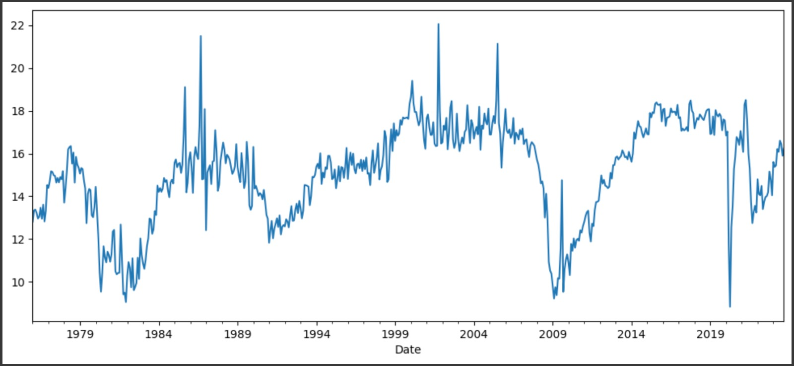
Monthly Data Plot

Slide 5
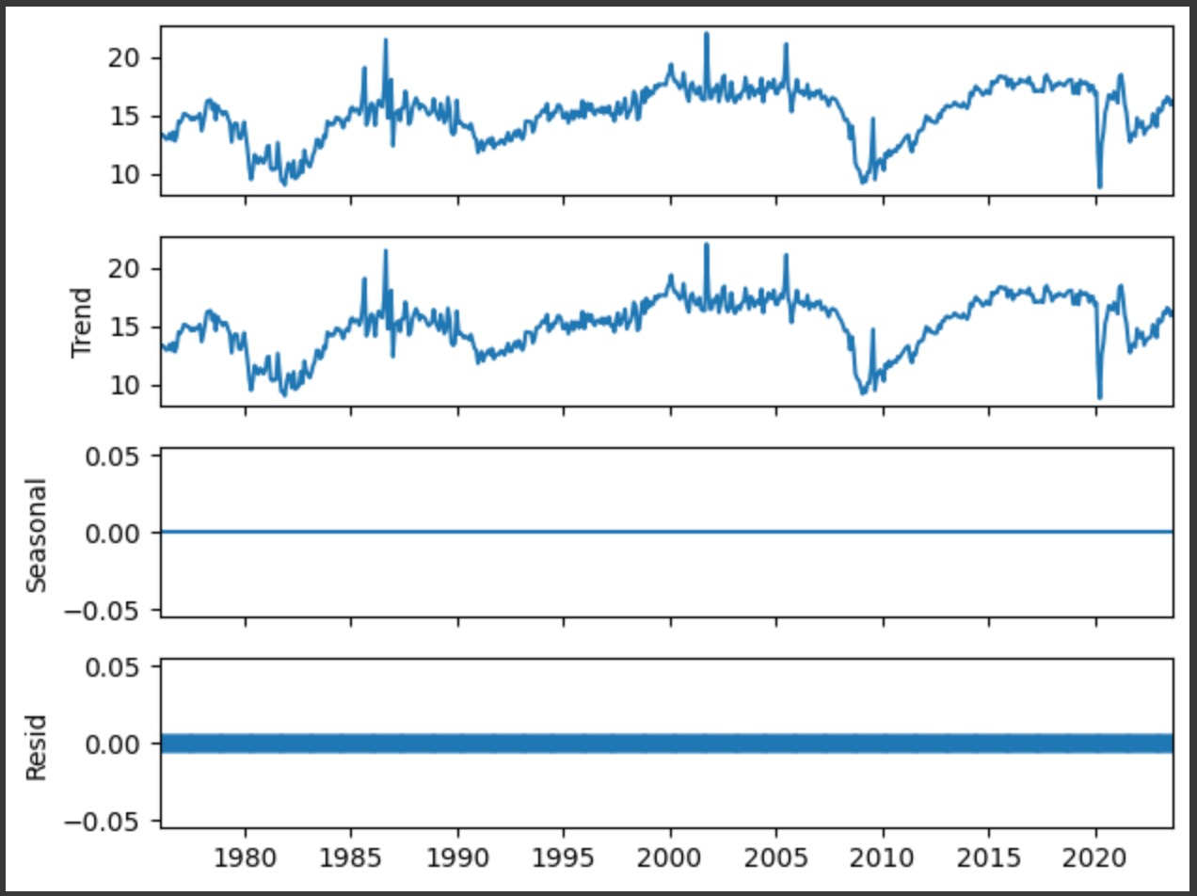
Decomposition
Whole data is based on trend and residuals. There is no seasonality

Slide 6
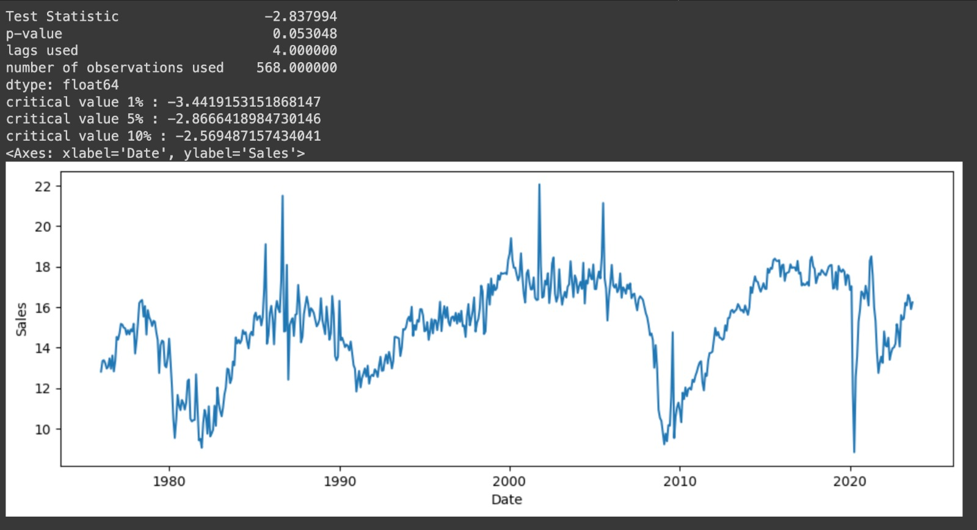
Testing for stationarity using adfuller test on original data

Slide 7
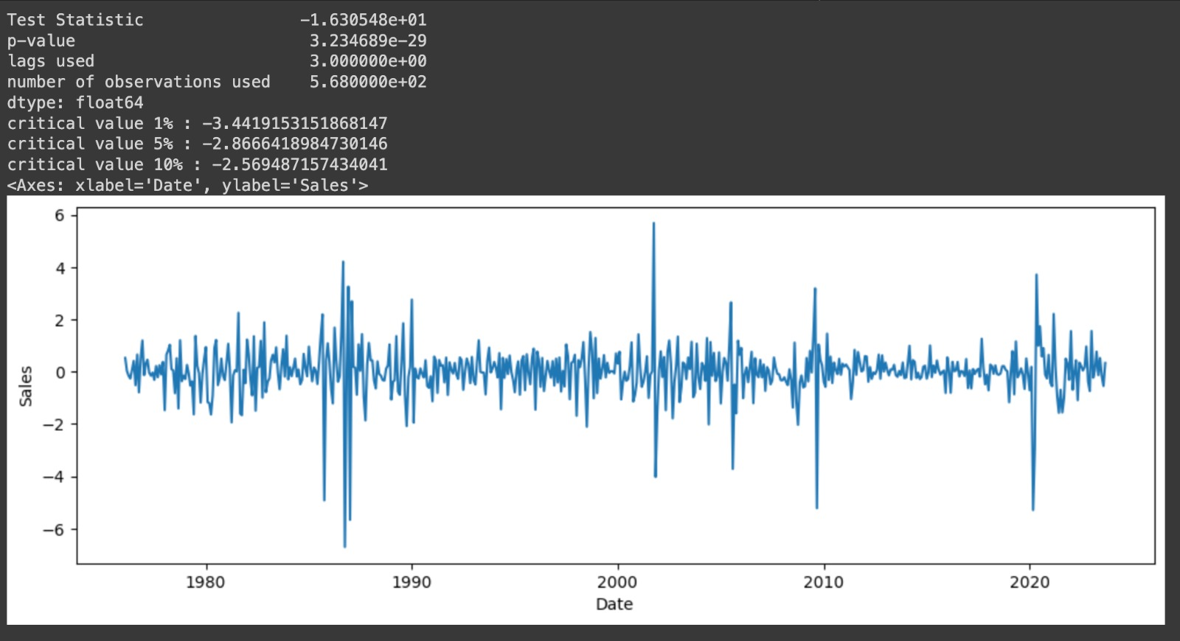
Testing for stationarity using adfuller test on differenced data

Slide 8
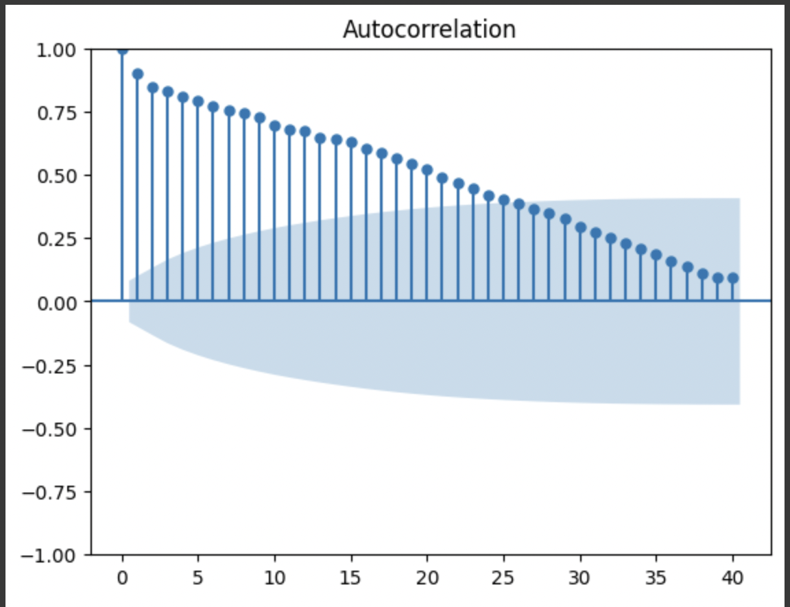
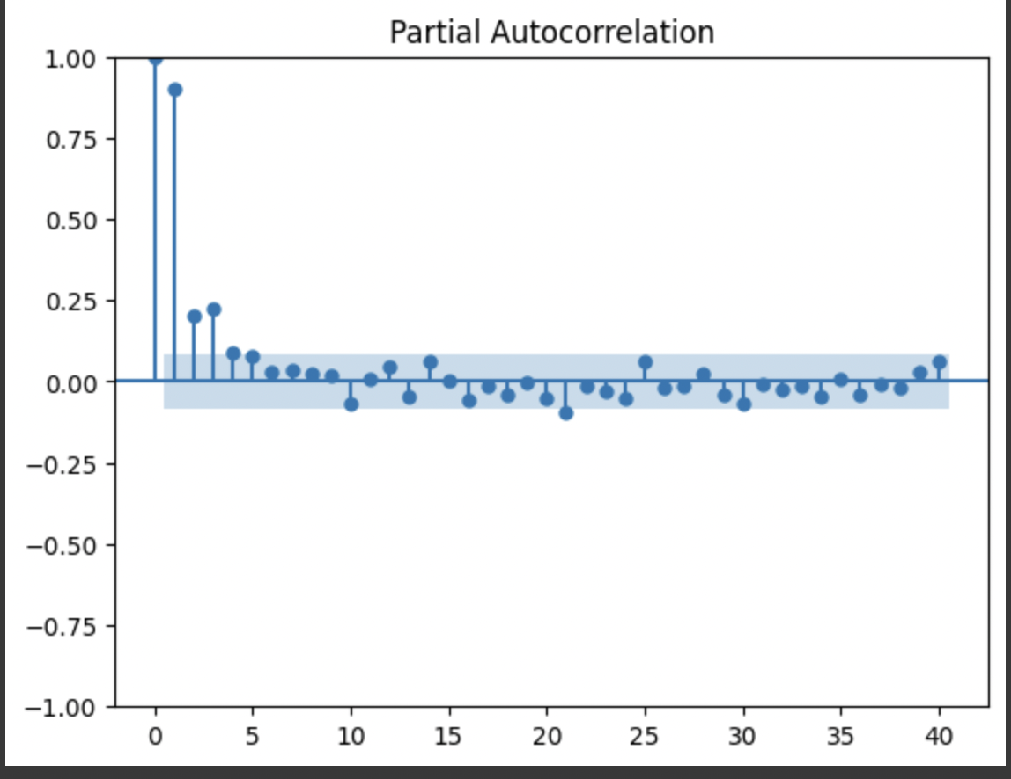
ACF and PACF Plot of original

Slide 9
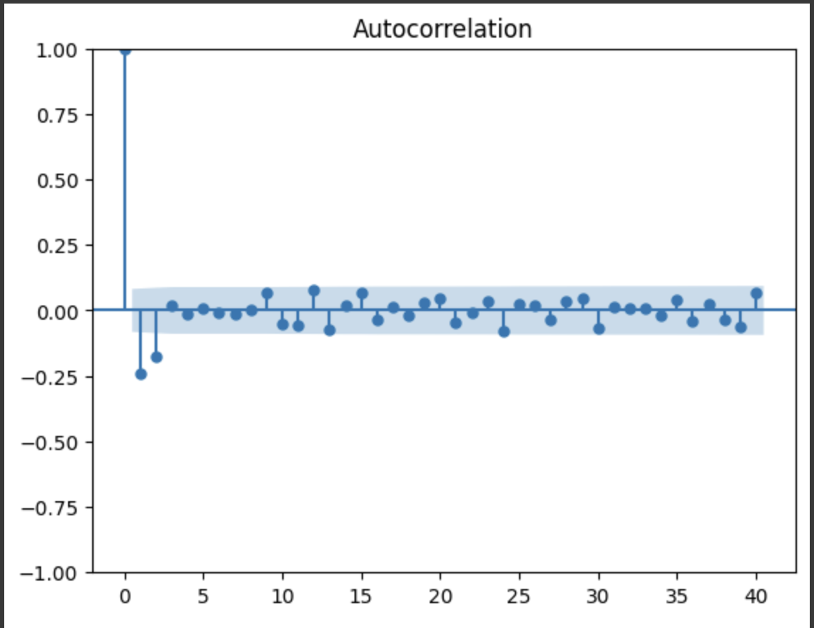
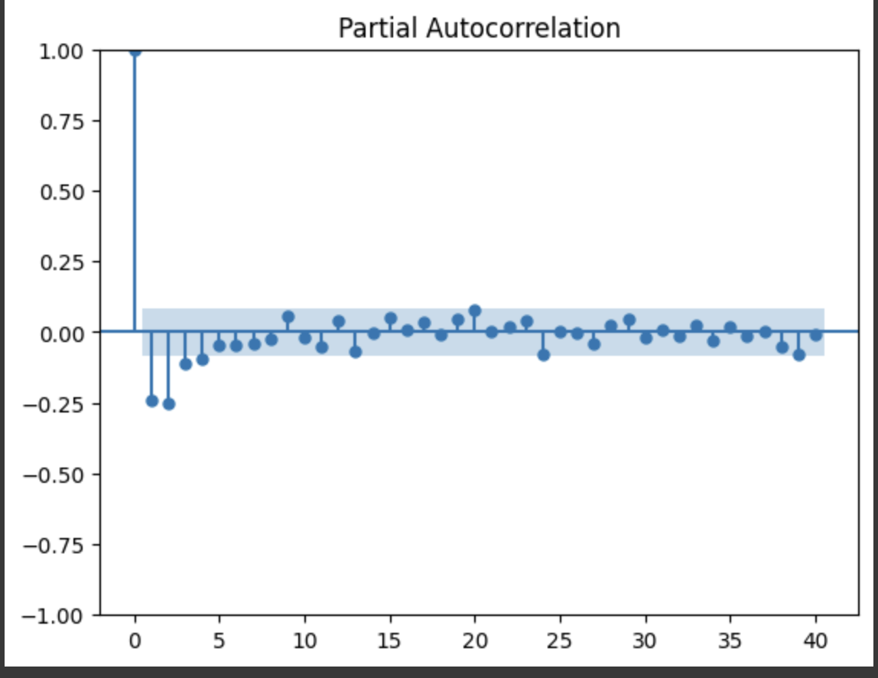
PACF Plot of Differenced data

Slide 10
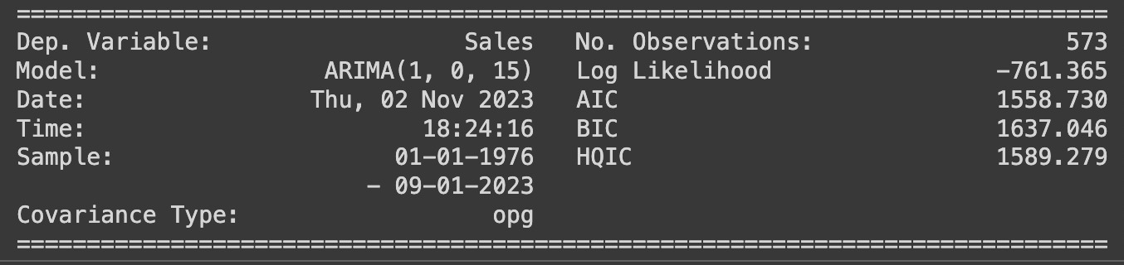
ARMA model for original data
P: 1, D: 0, Q: 15 AIC 1558

Slide 11
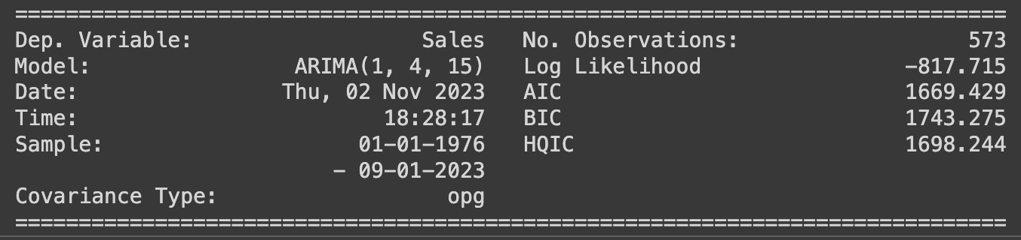
ARIMA model for original data
P: 1, D: 0, Q: 15 AIC 1669

Slide 12

ARIMA model for differenced data
P: 1, D: 0, Q: 15 AIC 1604

Slide 13
Model Selected
We chose The ARMA model on original data as it has the lowest AIC value.

Slide 14
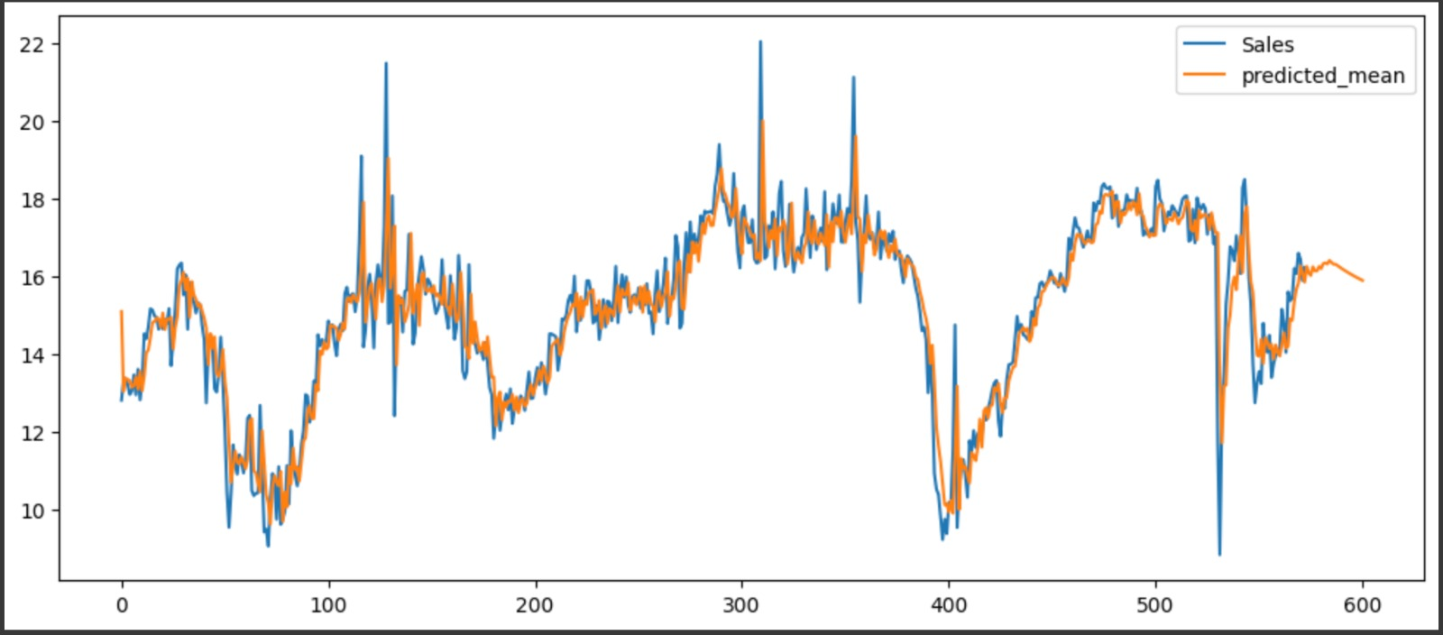
Forecasting

Slide 15
Thank You

